Slide 1
COMP6049 – Algorithm Design and Analysis
Topic 6 – Analysis of Data Structures: Graph (Basic Search & Traversal), Priority Queue, and Heap

Slide 2
Outline Materials
Types of graph
Implementation of graph using cost adjacency matrix
Implementation of graph using cost adjacency list

Slide 3
Outline Materials
Tree traversal
Depth First Search
Breadth First Search
DFS and BFS in Tree
DFS and BFS in Graph

Slide 4
Outline Materials
Concept of priority queue
Example of priority queue in our life
Concept of heap
Operations in heap
Heapsort

Slide 5
GRAPH
Graph is an ADT which consists of a set of nodes (points) and edges (lines).
An edge connects 1 or 2 nodes.
Edge, which only connect a node is called a loop edge.
Graph Type:
Directed Graph
Also referred to by the term digraph.
Undirected Graph

Slide 6
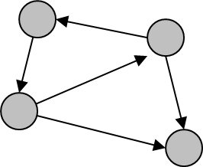
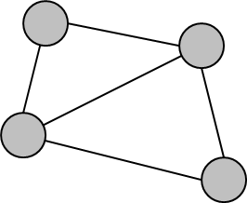
DIRECTED vs UNDIRECTED
Directed Graph
Undirected Graph

Slide 7
DEGREE OF NODE
In degree x is the number of edges coming into node x.
Out degree x is the number of edges out of node x.
A node that all its outward edge is called source.
A node that all its leading edge into is called sink.
In Undirected Graph there is only 1 degree nodes, which is a lot of side (edge) which cross on that node.

Slide 8
GRAPH REPRESENTATION
Graph can be represented in:
Illustrations
Linked-list
Adjacency matrix (and Cost Matrix)
Adjacency matrix: the proximity between two nodes
Adjacency matrix is made by calculating the adjacency list

Slide 9
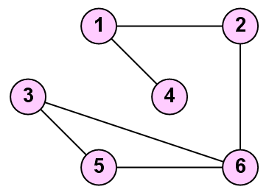
ADJACENCY LIST
A[1,2]=1
A[1,3]=0
A[1,4]=1
A[1,5]=0
A[1,6]=0
A[2,3]=0
A[2,4]=0
A[2,5]=0
A[2,6]=1
A[3,4]=0
A[3,5]=1
A[3,6]=1
A[4,5]=0
A[4,6]=0
A[5,6]=1

Slide 10
ADJACENCY LIST
The class definitions in C++ for the adjacency list representation are
Class Graph
{
private:
int n; //number of vertices
struct node {
int vertex;
struct node* link;
};
struct node* headnodes[n+1];
public:
Graph()
{ for (int i=1;i<=n;i++) headnodes[i] = NULL; }
};

Slide 11
EXAMPLE ADJACENCY MATRIX (1)
0 1 0 1 0 0
1 0 0 0 0 1
0 0 0 0 1 1
1 0 0 0 0 0
0 0 1 0 0 1
0 1 1 0 1 0

Slide 12
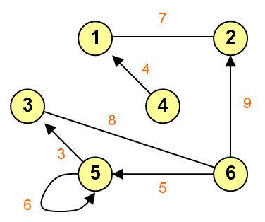
EXAMPLE ADJACENCY MATRIX (2)
0 7 0 0 0 0
7 0 0 0 0 0
0 0 0 0 0 8
4 0 0 0 0 0
0 0 3 0 6 0
0 9 8 0 5 0

Slide 13
COST MATRIX
If the adjacency matrix shown in proximity, then the Cost Matrix seen in the distance.
If there is no edge connecting
Adjacency matrix is 0
Cost Matrix valued ∞

Slide 14
EXAMPLE COST MATRIX
∞ 7 ∞ ∞ ∞ ∞
7 ∞ ∞ ∞ ∞ ∞
∞ ∞ ∞ ∞ ∞ 8
4 ∞ ∞ ∞ ∞ ∞
∞ ∞ 3 ∞ 6 ∞
∞ 9 8 ∞ 5 ∞

Slide 15
REVIEW TREE TRAVERSAL
Traversal is a process to visit each node in a tree.
Pre-order Traversal
parent–left–right
Level-order Traversal
parent–left–right
In-order Traversal
left–parent–right (this technique is only for Binary Tree)
Post-order Traversal
left–right–parent

Slide 16
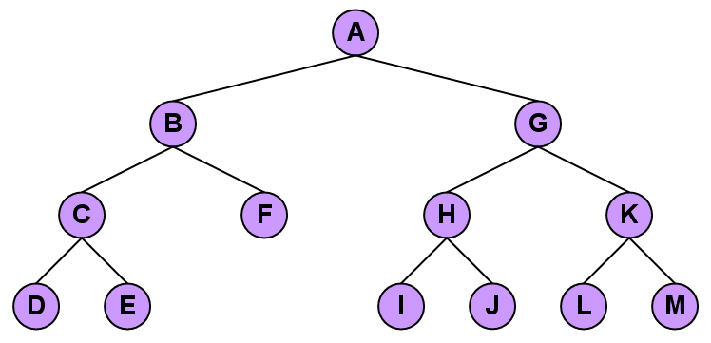
PRE-ORDER TRAVERSAL

Slide 17
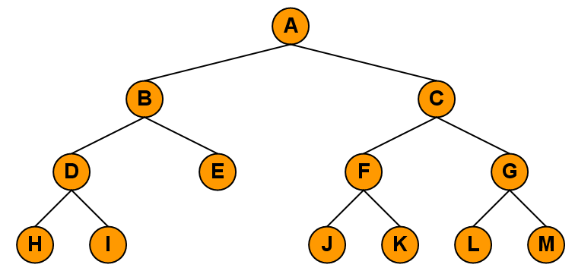
LEVEL-ORDER TRAVERSAL

Slide 18
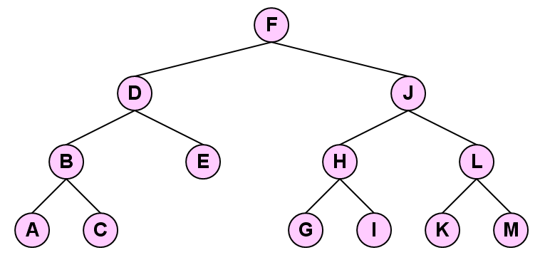
IN-ORDER TRAVERSAL

Slide 19
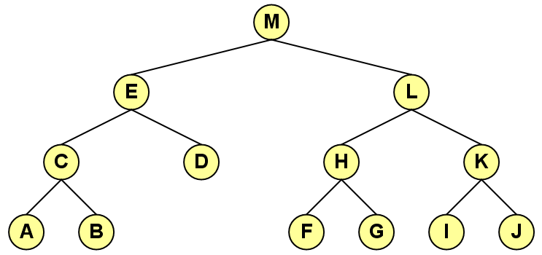
POST-ORDER TRAVERSAL

Slide 20
IMPLEMENTATION OF TREE DFS
Steps:
Set status to 1 (white color) to all nodes
Enter root node to a stack, set status to 2 (orange color)
Take top of the stack, set status to 3 (green color)
Enter left child and right child to the stack, set status to 2 (orange color)
Repeat step 3 until the stack is empty or searched data is found
Steps in the more "technical" term:
PUSH root node
POP node X dari stack
PUSH all children of node X to the stack
Repeat step 2

Slide 21
TREE DFS (1)
A
B
E
C
D
F
G

Slide 22
TREE DFS (2)
A
B
E
C
D
F
G
A
Stack

Slide 23
TREE DFS (3)
A
B
E
C
D
F
G
A
Stack

Slide 24
TREE DFS (4)
A
B
E
B
C
D
F
G
E
A
Stack

Slide 25
TREE DFS (5)
A
B
E
C
D
F
G
E
A
B
Stack

Slide 26
TREE DFS (6)
A
B
E
C
D
C
D
F
G
E
A
B
Stack

Slide 27
TREE DFS (7)
A
B
E
D
C
D
F
G
E
A
B
C
Stack

Slide 28
TREE DFS (8)
A
B
E
C
D
F
G
E
A
B
C
D
Stack

Slide 29
TREE DFS (9)
A
B
E
C
D
F
G
A
B
C
D
E
Stack

Slide 30
TREE DFS (10)
A
B
E
F
C
D
F
G
G
A
B
C
D
E
Stack

Slide 31
TREE DFS (11)
A
B
E
C
D
F
G
G
A
B
C
D
E
F
Stack

Slide 32
TREE DFS (12)
A
B
E
C
D
F
G
A
B
C
D
E
F
G
Stack

Slide 33
IMPLEMENTATION OF TREE BFS
Steps:
Set status to 1 (white color) to all nodes
Enter root node to a queue, set status to 2 (orange color)
Take the front of queue (bottom position), set status to 3 (green color)
Enter left child and right child to the queue, set status to 2
Repeat step 3 until queue is empty or searched data is found.
Steps in the more "technical" term:
PUSH root node a queue
POP node X from queue
PUSH all childrent of node X to the queue
Repeat step 2.

Slide 34
TREE BFS (1)
A
B
E
C
D
F
G

Slide 35
TREE BFS (2)
A
Queue
B
E
C
D
F
G
A

Slide 36
TREE BFS (3)
A
Queue
B
E
C
D
F
G
A

Slide 37
TREE BFS (4)
A
Queue
B
E
E
C
D
F
G
B
A

Slide 38
TREE BFS (5)
A
Queue
B
E
C
D
F
G
E
A
B

Slide 39
TREE BFS (6)
A
Queue
B
E
D
C
C
D
F
G
E
A
B

Slide 40
TREE BFS (7)
A
Queue
B
E
D
C
D
F
G
C
A
B
E

Slide 41
TREE BFS (8)
A
G
Queue
B
E
F
D
C
D
F
G
C
A
B
E

Slide 42
TREE BFS (9)
A
Queue
B
E
G
F
C
D
F
G
D
A
B
E
C

Slide 43
TREE BFS (10)
A
Queue
B
E
G
C
D
F
G
F
A
B
E
C
D

Slide 44
TREE BFS (11)
A
Queue
B
E
C
D
F
G
G
A
B
E
C
D
F

Slide 45
TREE BFS (12)
A
Queue
B
E
C
D
F
G
A
B
E
C
D
F
G

Slide 46
IMPLEMENTATION OF GRAPH DFS
Steps:
Represent graph in Adjacency List
Set all nodes status to 1
Enter the beginning node to stack, set status to 2
Take top of the stack, set status to 3
Enter node yang adjacent dengan yang baru diambil yang status 1 ke stack, set status to 2
Repeat steps above until the stack is empty or searched data is found.

Slide 47
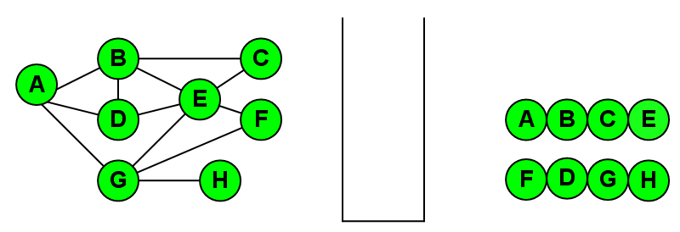
RESULTS OF DFS

Slide 48
IMPLEMENTATION OF GRAPH BFS
Steps:
Represent graph with the adjacency list
Set all nodes status 1
Enter the initial node to the queue, set the status to 2
Take a leading queue, set the status to 3
Enter the node adjacent to the newly drawn to the status of a queue, set the status to 2
Repeat the steps above until the queue is empty or the data sought is found

Slide 49
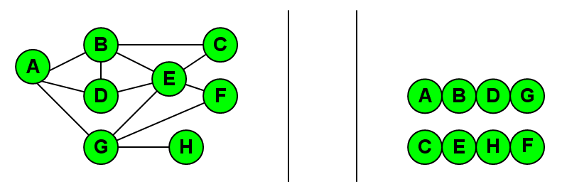
RESULTS OF BFS

Slide 50
PRIORITY QUEUE
Is the further development of the concept of Queue is a queue that each component consists of (key, value)
Priority Queue Example applications
Queue prospective passenger aircraft standby
Stock market

Slide 51
OPERATION IN PRIORITY QUEUE
InsertItem(k,v)
insert an element into a priority queue where k is the key and v is the value.
RemoveMin()
As POP operation is queue, getting "up front" element in the queue (with regard to priority).
GetMinKey()
Getting the smallest priority.
GetMinValue()
Getting the smallest value.
Size()
Getting the size of the queue.
IsEmpty()
Check whether the queue contains something or not.

Slide 52
IMPLEMENTATION OF PRIORITY QUEUE
Unsorted List
InsertItem O(1)
RemoveKey(), GetMinKey() O(n)
Sorted List
InsertItem O(n)
RemoveKey(), GetMinKey() O(1)

Slide 53
SORTING IN PRIORITY QUEUE
Selection Sort
Is the variation of PQ with an unsorted list
Adding a new element takes O (n)
Removing an element takes 1 +2 +3 +...+ n means O (n²)
Insertion Sort
Is the variation of PQ with a sorted list
Adding a new element takes 1 +2 +3 +...+ n means O (n²)
Removing an element takes O (n)

Slide 54
HEAP
Heap
Is a complete Binary Tree
Consists of internal nodes and external nodes
Each internal node stores a value
The values ​​at each node is eligible to Minimum Heap or Maximum Heap

Slide 55
MAXIMUM / MINIMUM HEAP
Maximum Heap
If root is greater than left sub tree and right subtree
Minimum Heap
If root is less than left sub tree and right subtree
Further discussion of using the Minimum Heap

Slide 56
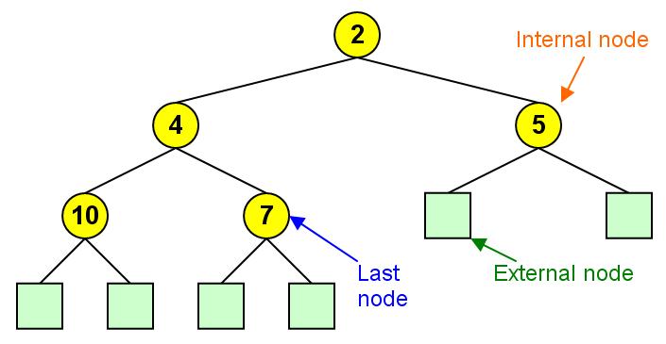
MINIMUM HEAP

Slide 57
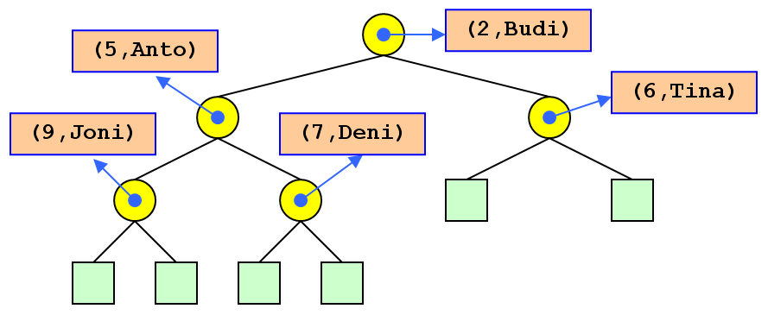
PRIORITY QUEUE IN HEAP

Slide 58
OPERATION IN HEAP
InsertNode(k)
Insert a new node into a heap.
RemoveNode
Removing the root node then heapify the heap.
Empty

Slide 59
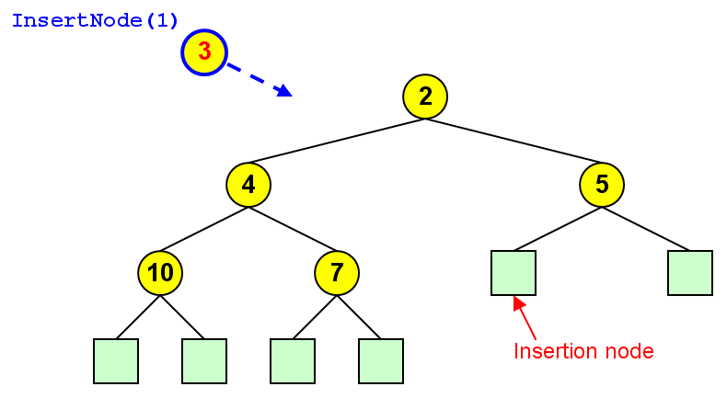
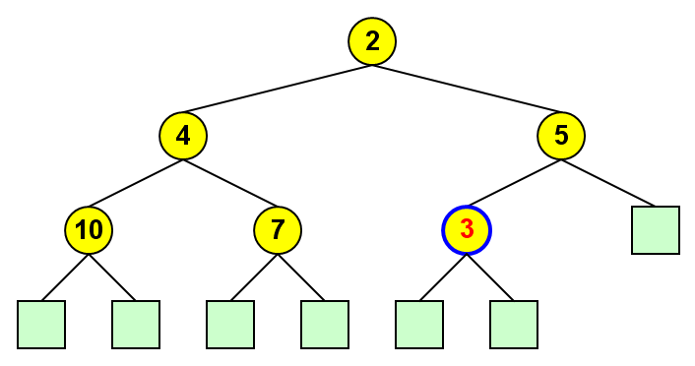
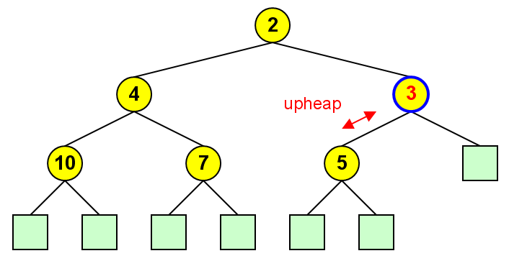
INSERT NODE

Slide 60
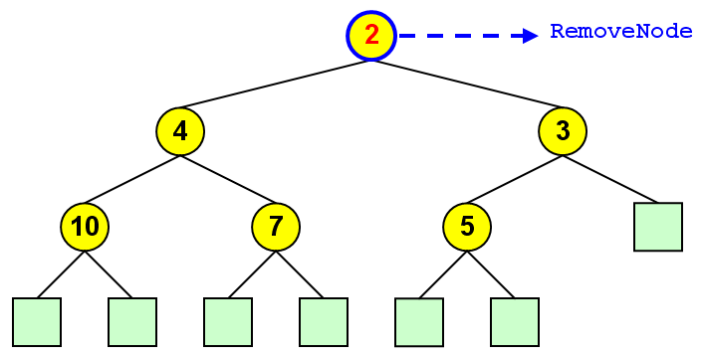
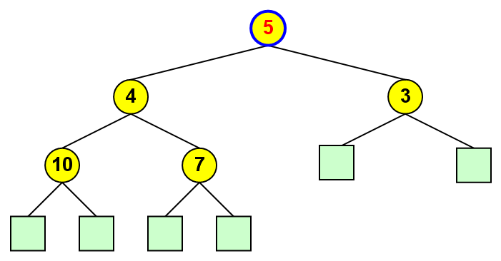
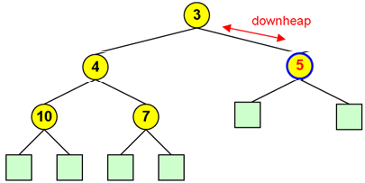
REMOVE NODE

Slide 61
HEAP SORT
Heap Sort is a sorting technique using the properties of heap.
Steps:
All values are entered into the heap
Heap then emptied by removing node one by one
Note each removed node
As a result, the numbers are sorted
Suppose we have a number of 21, 45, 15, 30 and 19 to sort.

Slide 62
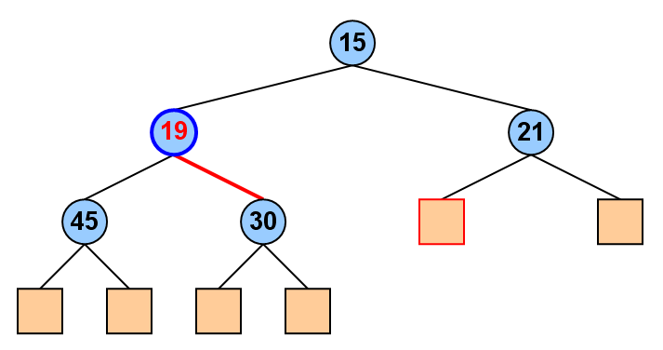
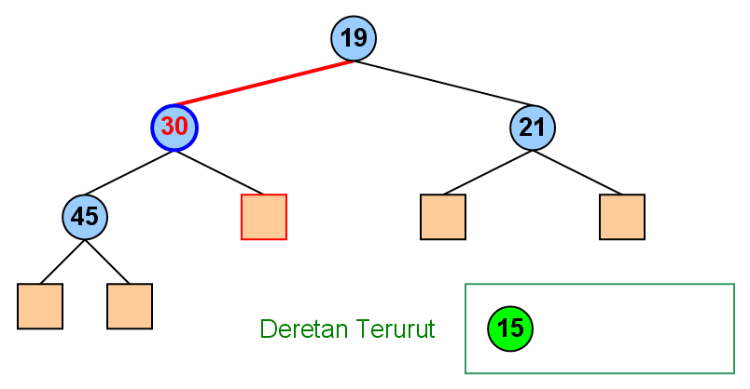
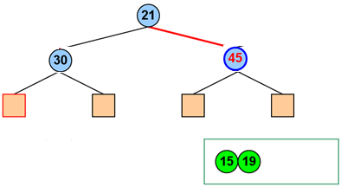
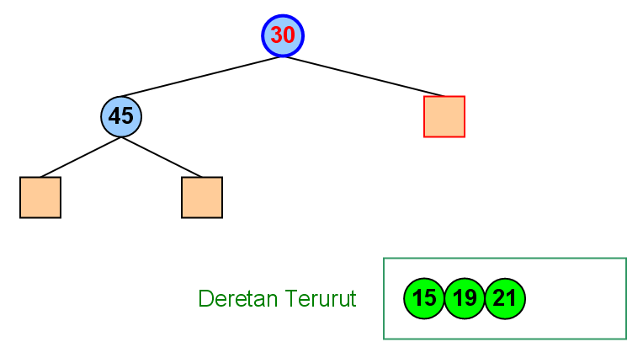
HEAP SORT SIMULATION

Slide 63

COMPLEXITY OF HEAP SORT
Complexity of Heap Sort algorithm consists:
Complexity in building heap
Complexity in removing all nodes in heap
Complexity of Heap Sort

Slide 64
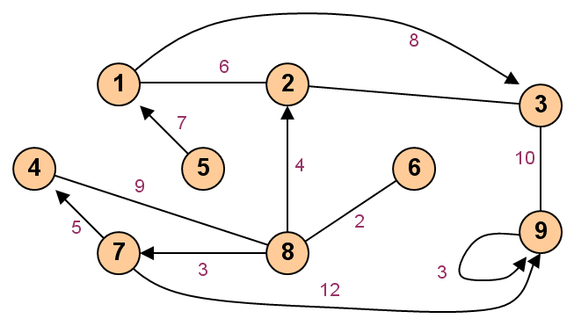
EXERCISE
Please produce the Adjacency Matrix and the Cost Matrix!

Slide 65
EXERCISE
Draw a tree with 14 vertices
Draw a directed acyclic graph with 6 vertices and 14 edges
Suppose that your computer only has enough memory to store 40000 entries. Which best graph data structure(s) – you can choose more than 1 -- should you use to store a simple undirected graph with 200 vertices, 19900 edges, and the existence of edge(u,v) is frequently asked?
Adjacency Matrix
Adjacency List
Edge List

Slide 66
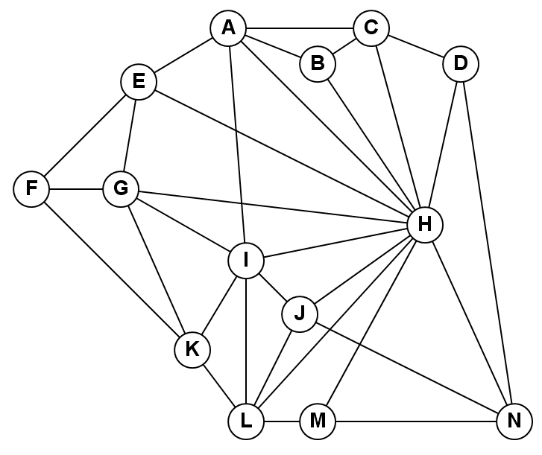
EXERCISE
Do implementation of DFS and BFS for the following graph:

Slide 67
EXERCISE
Make the steps of the followed the numbers 34, 15, 23, 9, 41, 26, 39, 11, 7, 28 by using Heap Sort!

Slide 68
REVIEW
GRAPH
DIRECTED vs UNDIRECTED GRAPH
DEGREE OF NODE
GRAPH REPRESENTATION
ADJACENCY LIST
COST MATRIX

Slide 69
REVIEW
Review tree traversal
Implementation of tree DFS
Implementation of tree BFS
Implementation of graph DFS
Implementation of graph BFS

Slide 70
REVIEW
PRIORITY QUEUE
OPERATION IN PRIORITY QUEUE
IMPLEMENTATION OF PRIORITY QUEUE
SORTING IN PRIORITY QUEUE
HEAP
MAXIMUM / MINIMUM HEAP
PRIORITY QUEUE IN HEAP
OPERATION IN HEAP
HEAP SORT
COMPLEXITY OF HEAP SORT

Slide 71
Q & A

Slide 72
References
S. Sridhar. 2014. Design and Analysis of Algorithms, 1/e. Oxford University Press. India. Chapter 5.6
Ellis Horowitz,Sanguthevar Rajasekaran,Sartaj Sahni. 1998. Computer algorithms/C++. 1STBL. New York. Chapter 2.6
Graph and its representations
http://www.geeksforgeeks.org/graph-and-its-representations/

Slide 73
References
Thomas H. Cormen. 2009. Introduction to algorithms. TMP. London. ISBN:9780262033848. Chapter 22
Breadth first search and depth first search
https://www.ics.uci.edu/~eppstein/161/960215.html

Slide 74
References
S. Sridhar. 2014. Design and Analysis of Algorithms, 1/e. Oxford University Press. India. Chapter 6
priority queue
http://pages.cs.wisc.edu/~vernon/cs367/notes/11.PRIORITY-Q.html

Slide 75
THANK YOU

